Slide 1

Principles of Good Software Design

Slide 2
Whether you are a software engineer, architect, team lead, or an engineering manager, it is important to understand design principles. Software engineering is all about making informed decisions, creating value for the business, and preparing for the future.
As a software engineer or architect, your job is to provide solutions that are the best fit for your business under constraints of limited money, time, and knowledge about the future.

Slide 3
Topics Covered
Simplicity
Hide complexity
Avoid over-engineering
Trying Test driven development
Loose coupling
Don’t Repeat Yourself (DRY)
Single Responsibility
Open Closed Principle
Inversion of Control
Designing to Scale
Cloning
Functional Partitioning
Data Partitioning
Self-healing systems

Slide 4
Simplicity
Keeping software simple is difficult because it is inherently relative.
There is no standardized measurement of simplicity, so when you judge what is simpler, you need to first ask yourself for whom and when.
For example, is it simpler for you or for your clients? Is it simpler for you to do now or maintain in the future?
It is about what would be the easiest way for another software engineer to use your solution in the future.
It is also about being able to comprehend the system as it grows larger and more complex.
There are four basic steps to start promoting simplicity within your products

Slide 5
Hide complexity and Build Abstractions
Hiding complexity and building abstractions is one of the best ways to promote simplicity.
When you look at a class, you should be able to quickly understand how it works without knowing all the details of how other remote parts of the system work
When you look at a module, you should be able to disregard the methods and think of the module as a set of classes
When you look at the application, you should be able to identify key modules and their higher-level functions, but without the need to know the classes’ details.
When you look at the entire system, you should be able to see only your top-level applications and identify their responsibilities without having to care about how they fulfill them.

Slide 6
Avoid Over-engineering
When you try to predict every possible use case and every edge case, you lose focus on the most common use cases.
In such a situation you can easily follow the urge of solving every problem imaginable and end up overengineering, which is building a solution that is much more complex than is really necessary.
Good design allows you to add more details and features later on but does not require you to build a massive solution up front.
Beginning with a reasonable level of abstraction and iterating over it gives better results than trying to predict the future and build everything that might be needed later on.

Slide 7
Trying Test Driven Development
Test-driven development is a set of practices where engineers write tests first and then implement the actual functionality.
The main benefits are that there is no code without unit tests and there is no “spare” code. Since developers write tests first, they would not add unnecessary functionality, as it would require them to write tests for it as well
In addition, tests can be used as a type of documentation, as they show you how the code was meant to be used and what the expected behavior was.
Since you have to write your test first, you have to imagine how would you use the component you are about to build, rather than focusing on the internal implementation of it.

Slide 8
Loose Coupling
Coupling is a measure of how much two components know about and depend on one another. The higher the coupling, the stronger the dependency.
Loose coupling refers to a situation where different components know as little as necessary about each other, whereas no coupling between components means that they are completely unaware of each other’s existence.
High coupling means that changing a single piece of code requires you to inspect in detail multiple parts of the system
The higher the overall coupling, the more unexpected the dependencies and higher chance of introducing bugs.
Low coupling promotes keeping complexity localized. By having parts of your system decoupled, multiple engineers can work on them independently.

Slide 9
Don’t Repeat Yourself (DRY)
Repeating yourself implies that you are undertaking the same activity multiple times. There are many areas in your software engineering life where this can be applied, from the code you write in your applications, to repetitive testing before each code release, to your company operations as a whole.
Following an inefficient processes
Lack of automation
Copy/paste programming
reinventing the wheel
“I won’t need it again so let’s just hack it quickly” solutions

Slide 10
Coding to Contract
Coding to contract is primarily about decoupling clients from providers. By creating explicit contracts, you extract the things that clients are allowed to see and depend upon.
A contract is a set of rules that the provider of the functionality agrees to fulfill. It defines a set of things that clients of the code may assume and depend upon.
It dictates how a piece of software can be used and what functionality is available, but does not require clients to know how this functionality is implemented.
As long as you keep the contract intact, clients and providers can be modified independently. This in turn makes your code changes more isolated and thus simpler.

Slide 11
Single Responsibility
Keep class length below two to four screens of code.
Ensure that a class depends on no more than five other interfaces/classes
Ensure that a class has a specific goal/purpose.
Summarize the responsibility of the class in a single sentence and put it in a comment on top of the class name. If you find it hard to summarize the class responsibility, it usually means that your class does more than one thing

Slide 12
Open Closed Principle
The open-closed principle is about creating code that does not have to be modified when requirements change or when new use cases arise. Open-closed stands for “open for extension and closed for modification.”
The prime objective of this principle is to increase flexibility of your software and make future changes cheaper

Slide 13
Inversion of Control
Inversion of control (IOC) is a method of removing responsibilities from a class to make it simpler and less coupled to the rest of the system.
At its core, inversion of control is not having to know who will create and use your objects, how, or when. It is about being as dumb and oblivious as possible, as having to know less is a good thing for software design.
This means your classes do not have to know when their instances are created, who is using them, or how their dependencies are put together. Your classes are plugins, and some external force will decide how and when they should be used.

Slide 14
Dependency Injection
Dependency injection is a simple technique that reduces coupling and promotes the open-closed principle.
Dependency injection provides references to objects that the class depends on, instead of allowing the class to gather the dependencies itself
https://www.baeldung.com/inversion-control-and-dependency-injection-in-spring

Slide 15
Designing for Scale
As you learn more about scalability, you may realize that many of the scalability solutions can be boiled down to three basic design techniques:
Adding more clones - Adding indistinguishable components
Functional partitioning - Dividing the system into smaller subsystems based on functionality
Data partitioning - Keeping a subset of the data on each machine

Slide 16
Adding more Clones
If you are building a system from scratch, the easiest and most common scaling strategy is to design it in a way that would allow you to scale it out by simply adding more clones.
A clone here is an exact copy of a component or a server.
Any time you look at two clones, they have to be interchangeable and each of them needs to be equally qualified to serve an incoming request.
Databases have been scaling out using this technique for years through the use of replication.

Slide 17
Functional Partitioning
The main thought behind the functional partitioning technique is to look for parts of the system focused on a specific functionality and create independent subsystems out of them.
In the context of infrastructure, functional partitioning is the isolation of different server roles.
In a more advanced form, functional partitioning is dividing a system into self-sufficient applications.
Object cache servers, message queue servers, queue workers, web servers, data store engines, and load balancers, each of these components could be built into the main application, but over the years, engineers realized that a better solution is to isolate different functions into independent subsystems.

Slide 18
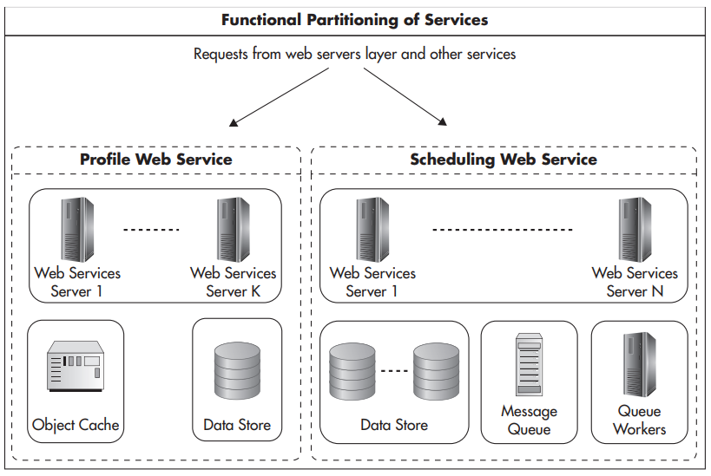

Slide 19
Data Partitioning
Partition the data to keep subsets of data set on each machine instead of cloning the entire data set onto each machine
This is a manifestation of the share-nothing principle, as each server has its own subset of data, which it can control independently. Share nothing is an architectural principle where each node is fully autonomous
Each node can make its own decisions about its state without the need to propagate state changes to its peers. Not sharing state means there is no data synchronization, no need for locking, and that failures can be isolated because nodes do not depend on one another.
Each server gets a subset of the data for which it is solely responsible. By having less data on each server, I can process it faster and store more of it in memory

Slide 20
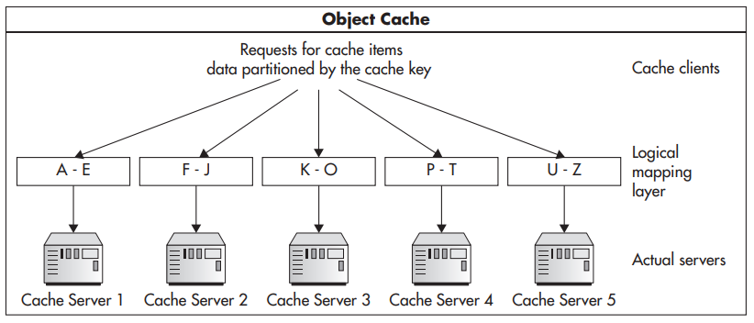

Slide 21
Design for Self-Healing
Any sufficiently large system is in a constant state of partial failure
A system is considered to be available as long as it performs its functions as expected from the client’s perspective. It does not matter if the system is experiencing internal partial failure as long as it does not affect the behavior that clients depend on.
In other words, you want to make your system appear as if all of its components were functioning perfectly even when things break and during maintenance times.

Slide 22
A highly available system is a system that is expected to be available to its clients most of the time.
Instead of defining an absolute measure of high availability, systems are measured in the “number of nines.” We say a system with 2 nines is available 99 percent of the time, translating to roughly 3.5 days of outage per year (365 days * 0.01 = 3.65 days).
In comparison, a system with availability of 5 nines would be available 99.999 percent of the time, which makes it unavailable only five minutes per year

Slide 23
In practice, ensuring high availability is mainly about removing single points of failure and graceful failover.
Single point of failure is any piece of infrastructure that is necessary for the system to work properly. An example of a single point of failure can be a Domain Name System (DNS) server, if you have only one. It can also be a database master server or a file storage server.
A simple way to identify single points of failure is to draw your data center diagram with every single device (routers, servers, switches, etc.) and ask yourself what would happen if you shut them down one at a time.
Once you identify your single points of failure, you need to decide with your business team whether it is a good investment to put redundancy in place.
Redundancy is having more than one copy of each piece of data or each component of the infrastructure. Should one of the copies fail, your system can use the remaining clones to serve clients’ requests

Slide 24
Systems that are not redundant need special attention, and it is a best practice to prepare a disaster recovery plan (sometimes called a business continuity plan) with recovery procedures for all critical pieces of infrastructure.
Finally, if you had a system that was highly available and fully fault tolerant, you may want to implement self-healing. Self-healing is a property going beyond graceful failure handling; it is the ability to detect and fix problems automatically without human intervention.
Self-healing systems are a holy grail of web operations, but they are much more difficult and expensive to build than it sounds.

Slide 25
When a system can detect its own partial failure, prevent unavailability, and fully fix itself as soon as possible, you have a self healing system. Minimizing the mean time to recovery and automating the repair process is what self-healing is all about.
Mean time to recovery is one of the key components of the availability equation. The faster you can detect, react to, and repair, the higher your availability becomes. Availability is actually measured as mean time to failure / (mean time to failure + mean time to recovery).
By reducing the time to recovery, you can increase your availability, even if the failure rate is out of your control.

Slide 26
Summary
The “cleanest” solution is not always the best if it takes more time to develop or if it introduces unnecessary management costs. For example, the line between decoupling and over-engineering is very fine. It is your job to watch out for these temptations and not become biased toward the coolest solution imaginable.
Your business needs to make informed tradeoffs between scalability, flexibility, high availability, costs, and time to market.
Don’t be afraid to break the rules, if you really believe it is the best thing for your business or for your software.
Every system is different and every company has different needs, and you may find yourself working in a very different context than other engineers.
There is no single good way to build scalable software, but first learn your craft, learn your tools, and look for reasons to drive your decisions.

Slide 27
Hands-On (Installing Flask Framework)

Slide 28
Install Python 3 & Flask
https://www.geeksforgeeks.org/download-and-install-python-3-latest-version/
Make sure pip is installed along with python
https://flask.palletsprojects.com/en/3.0.x/installation/
Then use “pip install flask” to install flask framework

Slide 29
References
https://www.geeksforgeeks.org/python-programming-language/
https://flask.palletsprojects.com/en/3.0.x/
https://www.youtube.com/watch?v=3c-iBn73dDE
https://www.youtube.com/watch?v=42Q65H8ch7U

Slide 30
GitHub Link FOR THE PROJECT
https://github.com/saisupreeth97/Class-Hands-On-Project-Using-Docker-Gunicorn-and-NGINX/tree/master

